Slide 1
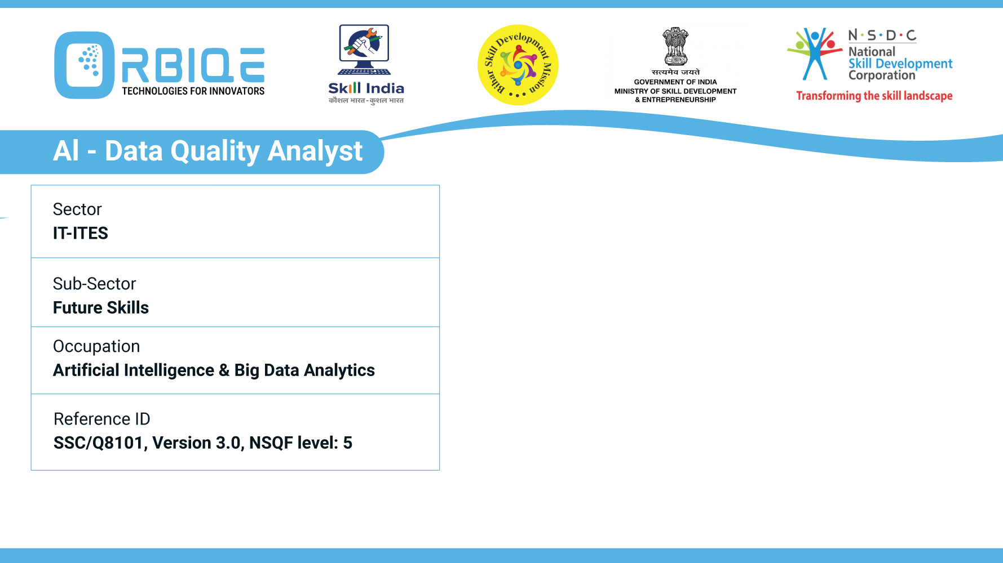

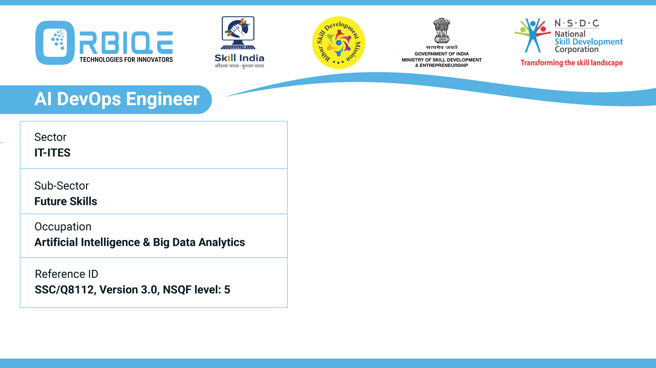
Name- Krishna Kant Dubey

Slide 2

Practical-Pre-processing Data

Slide 3
Agenda
Analyze unprocessed data to discover anomalies such as missing values, incorrect data types, etc.
Apply different techniques and functions to clean unprocessed data including removing missing values, transforming incorrect data types, etc.

Slide 4
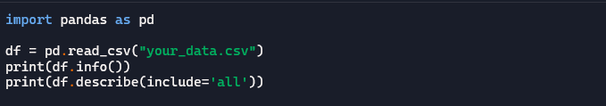
Step-by-Step Analysis of Unprocessed Data
Initial Data Inspection
Basic profiling to get an overview of the dataset

Slide 5


Step-by-Step Analysis of Unprocessed Data
Detect Missing Values
Identify missing or null entries:
Helps prioritize columns with high missing rates.
You can visualize it with

Slide 6

Step-by-Step Analysis of Unprocessed Data
Identify Incorrect Data Types
Check for mismatches between expected and actual types
Then validate:
Numeric columns: Ensure they don’t contain strings or mixed types.
Date columns: Convert and check for parsing errors.

Slide 7
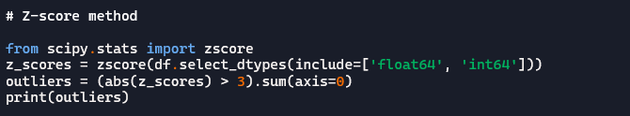

Step-by-Step Analysis of Unprocessed Data
Detect Outliers and Invalid Entries
Check for Duplicates

Slide 8

Step-by-Step Analysis of Unprocessed Data
Automated Profiling Tools

Slide 9

Step-by-Step Data Cleaning Techniques
Remove or Handle Missing Values
Detect Missing Values
Remove Missing Rows and Columns

Slide 10
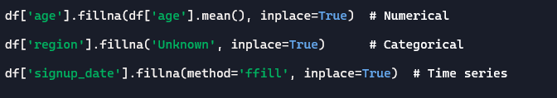
Step-by-Step Data Cleaning Techniques
Fill Missing Values

Slide 11
Transform Incorrect Data Types
Convert Strings to Numbers
Convert String to Dates
Convert Booleans

Slide 12
Standardize Categorical Values
Fix Inconsistent Values
Encode Categories
Remove Duplicates

Slide 13

Standardize Categorical Values
Cap or Remove Outliners
Rename Columns for Consistency

Slide 14
Thank You

